Slide 1
Neural Network from Scratch
Abdullah Mujeeb Khawaja
287624/KHAWA30700

Slide 2
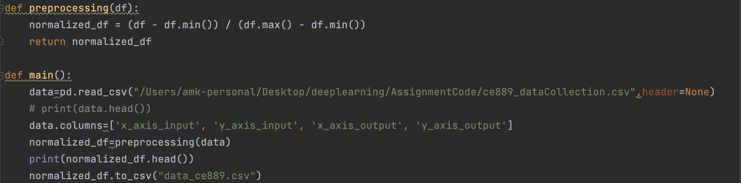
Preprocessing
Normalized as suggested in the lab
We could further delete any duplicates, or up-sample the dataset given I have 23K rows.

Slide 3
Basic Network
The neural network is a basic 2 input, 2 neurons in the hidden layer, and 2 outputs.
Additionally, the network has a random -1,1 weight generation mechanism, random learning rate initializer, and a random lambda that gets multiplied within the activation function (sigmoid).
The data is broken down via train_test_split of sklearn and indexes are reset.
The RMSE [Train,Test] is calculated after appending all the errors calculated over the data space.
Early Stopping, and Learning Rate Decay mechanism is also added into the network to control the direction so the model converges better.

Slide 4
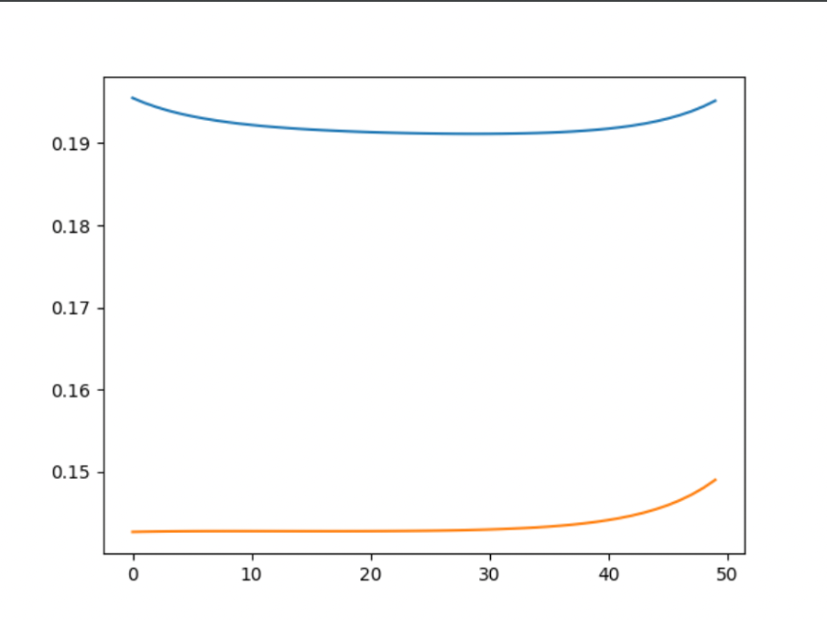
Without LRDecay & Random Starts[LR,Lambda]
With a static lr of 0.5 and a lambda of 0.6, the x and y rmse is plotted for train dataset as at that time, the validation plotting and code was yet to be implemented

Slide 5
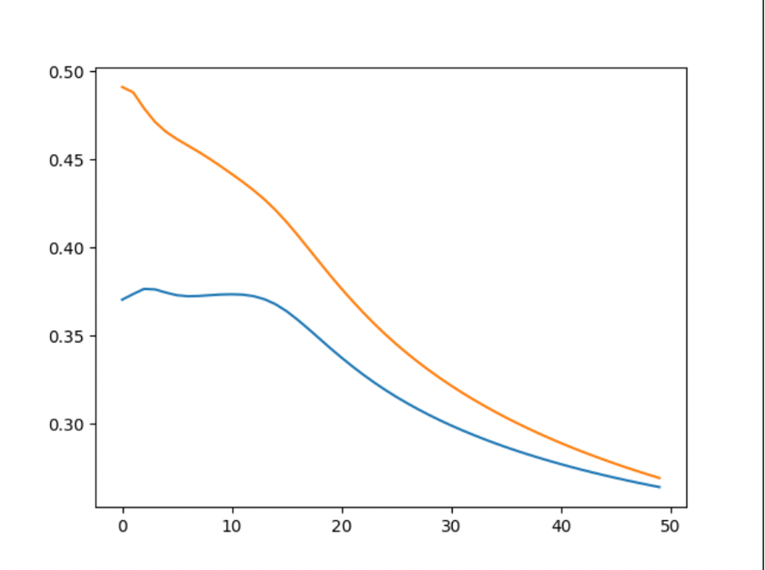
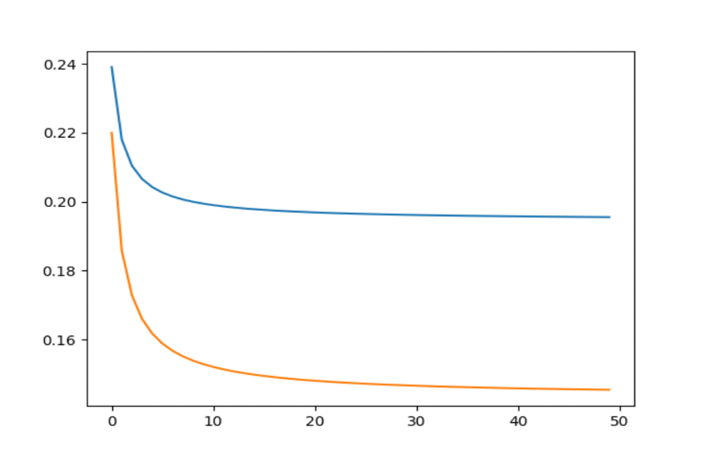
Including LRDecay & Random Start [LR,Lambda]
The convergence is almost immediately noticeable, and yes I know, the starting point is much higher, but with multiple restarts, the point of loss going downwards was consistent.
Further csv is also built to maintain the initial lr, lambda, error and ending lr,lambda and error.

Slide 6
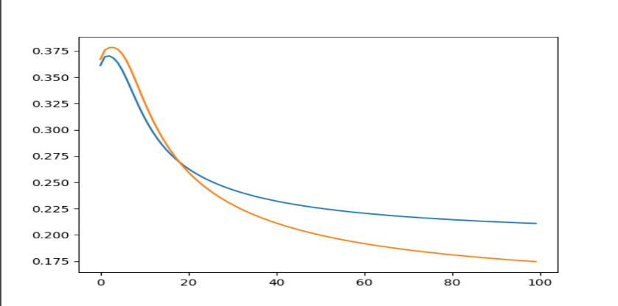
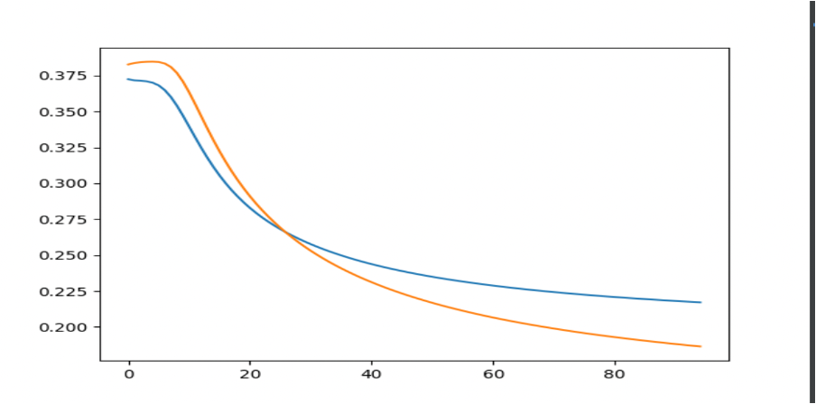
Early Stopping Implementation
The first figure shows that the network goes stale after 80th epoch, and that is the network without Early Stopping mechanism.
The second figure shows that the network gets killed after 80th epoch as the network goes stale.
The Early Stopping mechanism, I have also included a patience variable to compare how many epochs to compare on before making a decision.

Slide 7
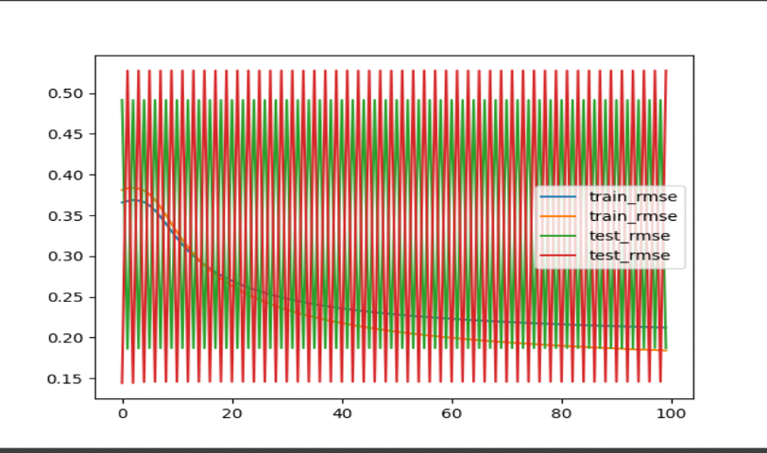
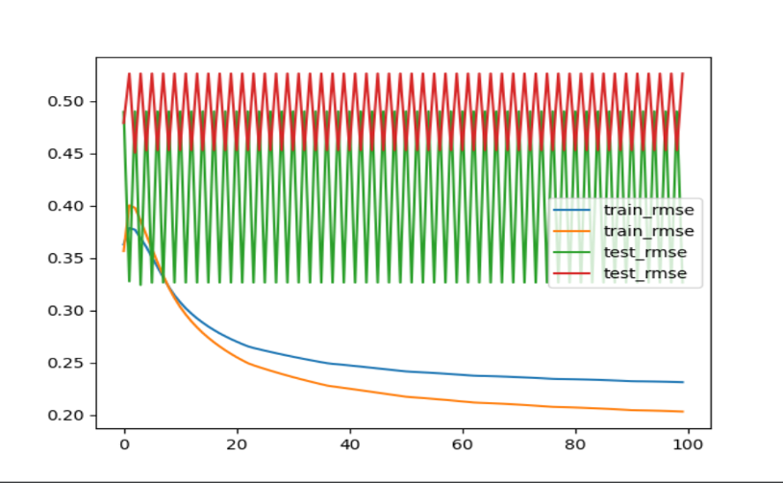
Regularization Adjustment: Issues & Solution
When rounding off the lambda to 3 decimal points, the figure 1 shows that it would get stuck in the saddle point and the network would isolate crazily as the error would rise one time, and decrease another, and then get stuck in that loop endlessly until either epochs run out or somehow magically the LRDecay does its magic and EarlyStopping is triggered.
The second figure has the adjustment done with 4 decimal points and alas, the train and test do not converge, it is still less oscillating.

Slide 8
Further Material
Further methods to save best weights, last weights were also added into the code
I also added a csv writer to write down initial learning rate and lambda and the ending learning rate and lambda with the loss noted to see what the best values would be for the network.
Additional strategies to shift regularization w.r.t test data performance was also done

Slide 9
The End

